Slide 1
Module 2: Scaling VLANs
CCNA Routing and Switching
Scaling Networks v6.0
Notes:
Cisco Networking Academy Program
Scaling Networks v6.0
Chapter 2: Scaling VLANs

Slide 2
Chapter 2 - Sections & Objectives
2.1 VTP, Extended VLANs, and DTP
Configure enhanced inter-switch connectivity technologies.
Compare VTP versions 1 and 2.
Configure VTP versions 1 and 2.
Configure extended VLANs.
Configure Dynamic Trunking Protocol (DTP).
2.2 Troubleshoot Multi-VLAN Issues
Troubleshoot common VTP and DTP issues in an inter-VLAN routed environment.
Notes:
2
Cisco Networking Academy Program
Scaling Networks v6.0
Chapter 2: Scaling VLANs

Slide 3
Chapter 2 - Sections & Objectives (Cont.)
2.3 Inter VLAN Routing Operation
Describe options for configuring inter-VLAN routing.
Configure router-on-a-stick inter-VLAN routing.
Configure inter-VLAN routing using Layer 3 switching.
2.4 Troubleshooting inter VLAN routing
Troubleshoot common inter-VLAN configuration issues.
Notes:
3
Cisco Networking Academy Program
Scaling Networks v6.0
Chapter 2: Scaling VLANs

Slide 4
2.1 VTP, Extended VLANs, and DTP
Notes:
2 – Scaling VLANs
2.1 – VTP, Extended VLANs, and DTP

Slide 5
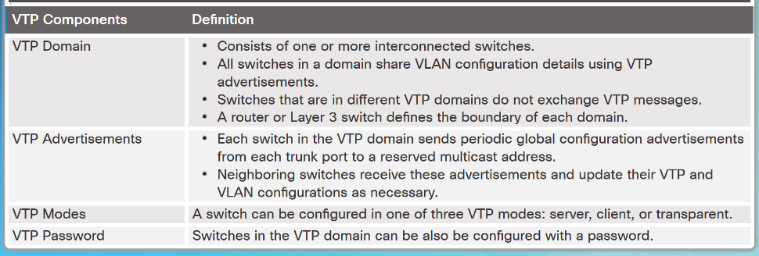
VTP Concepts and Operation VTP Overview
VLAN trunking protocol (VTP) allows a network administrator to manage VLANs on a switch configured as a VTP server.
The VTP server distributes and synchronizes VLAN information over trunk links to VTP-enabled switches throughout the switched network.
Notes:
2.1 – VTP, Extended VLANs, and DTP
2.1.1 – VTP Concepts and Operation
2.1.1.1 – VTP Overview

Slide 6
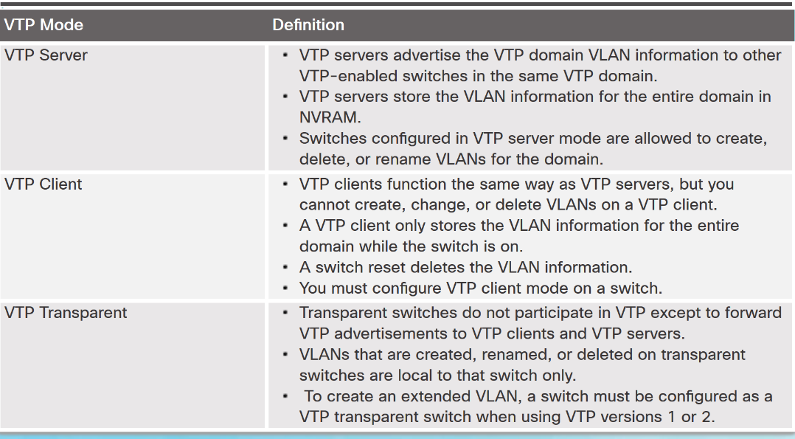
VTP Concepts and Operation VTP Modes
Notes:
2.1 – VTP, Extended VLANs, and DTP
2.1.1 – VTP Concepts and Operation
2.1.1.2 – VTP Modes

Slide 7
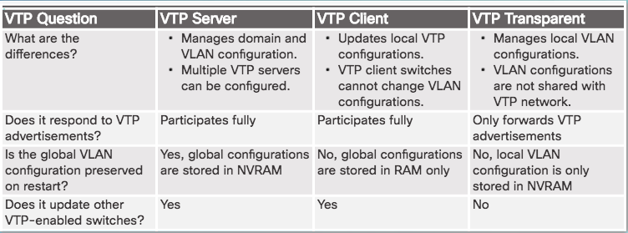
VTP Concepts and Operation VTP Modes (Cont.)
Notes:
2.1 – VTP, Extended VLANs, and DTP
2.1.1 – VTP Concepts and Operation
2.1.1.2 – VTP Modes

Slide 8
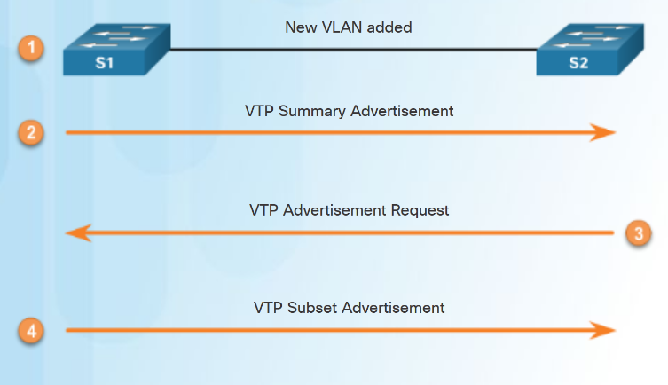
VTP Concepts and Operation VTP Advertisements
Three types of VTP Advertisements:
Summary advertisements – contain VTP domain name and configuration revision number.
Advertisement request - response to a summary advertisement message when the summary advertisement contains a higher configuration revision number than the current value.
Subset advertisements - contain VLAN information including any changes.
Notes:
2.1 – VTP, Extended VLANs, and DTP
2.1.1 – VTP Concepts and Operation
2.1.1.3 – VTP Advertisements

Slide 9
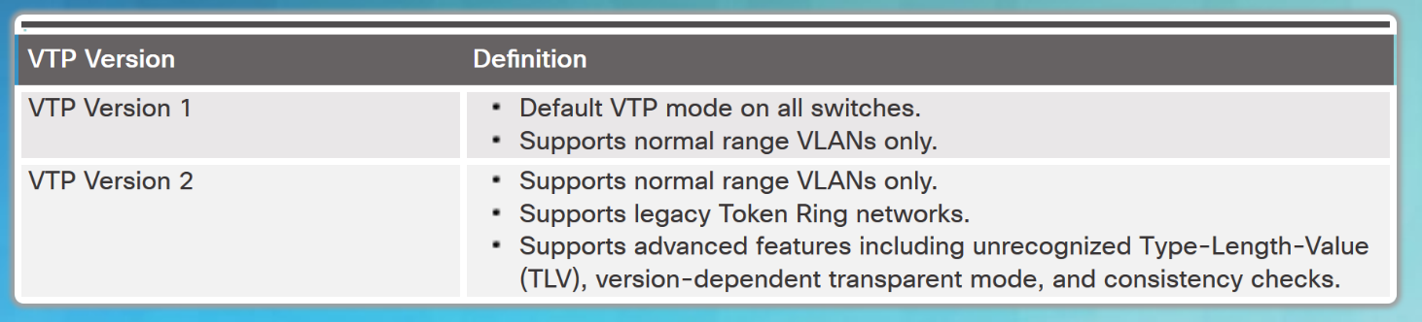
VTP Concepts and Operation VTP Versions
Switches in the same VTP domain must use the same VTP version.
Note: The newest version of VTP is Version 3, which is beyond the scope of this course.
Notes:
2.1 – VTP, Extended VLANs, and DTP
2.1.1 – VTP Concepts and Operation
2.1.1.4 – VTP Versions

Slide 10
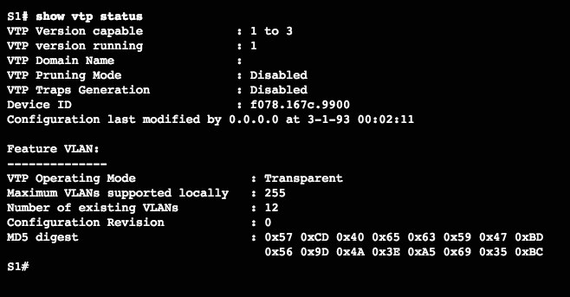
VTP Concepts and Operation Default VTP configuration
The show vtp status command displays the VTP status which includes the following:
VTP Version capable and running
VTP Domain Name
VTP Pruning Mode
VTP Traps Generation
Device ID
Configuration Last Modified
VTP Operating Mode
Maximum VLANs Supported Locally
Number of Existing VLANs
Configuration Revision
MD5 Digest
Verify Default VTP Status
Notes:
2.1 – VTP, Extended VLANs, and DTP
2.1.1 – VTP Concepts and Operation
2.1.1.5 – Default VTP configuration

Slide 11
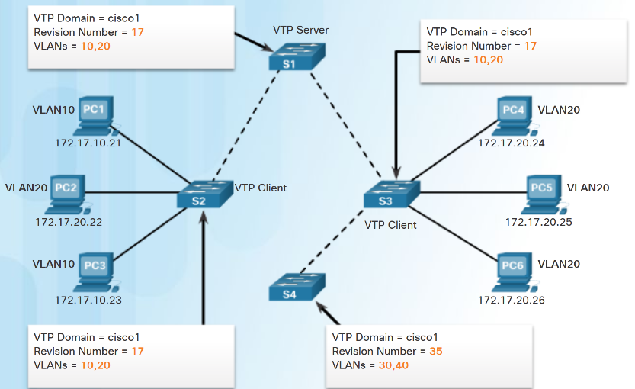
VTP Concepts and Operation VTP Caveats
VTP configuration revision number is stored in NVRAM.
To reset VTP configuration revision number to zero:
Change the switch's VTP domain to a nonexistent VTP domain and then change the domain back to the original name.
Change the switch's VTP mode to transparent and then back to previous VTP mode.
Notes:
2.1 – VTP, Extended VLANs, and DTP
2.1.1 – VTP Concepts and Operation
2.1.1.6 – VTP Caveats

Slide 12
VTP Concepts and Operation VTP Caveats (Cont.)
See graphic:
S4 is added. The startup config has not been erased and VLAN.DAT file on S4 has not been deleted. S4 has the same VTP domain name configured as other two switches but its revision number is 35, which is higher than the revision number on the other two switches.
S4 has VLAN 1 and is configured with VLAN 30 and 40. S4 does not have VLANs 10 and 20 in its database. Because S4 has a higher revision number, the rest of the switches in the domain will sync to S4’s revision.
Consequence is VLANs 10 and 20 will no longer exist on the switches, leaving clients that are connected to ports belonging to those non-existing VLANs without connectivity.
Notes:
2.1 – VTP, Extended VLANs, and DTP
2.1.1 – VTP Concepts and Operation
2.1.1.6 – VTP Caveats

Slide 13
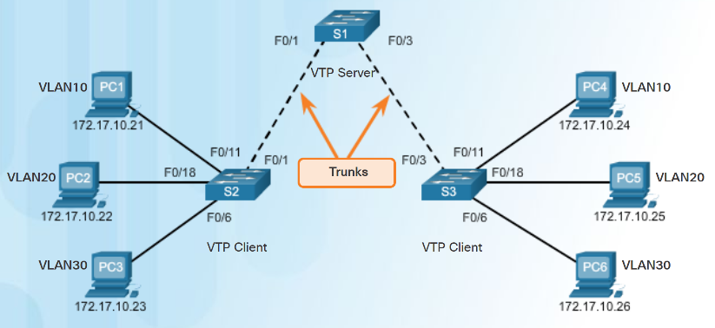
VTP Configuration VTP Configuration Overview
Steps to Configure VTP:
Step 1 - Configure the VTP Server
Step 2 - Configure the VTP Domain Name and Password
Step 3 - Configure the VTP Clients
Step 4 - Configure VLANs on the VTP Server.
Step 5 - Verify the VTP clients have received the new VLAN information.
Notes:
2.1 – VTP, Extended VLANs, and DTP
2.1.2 – VTP Configuration
2.1.2.1 – VTP Configuration Overview

Slide 14
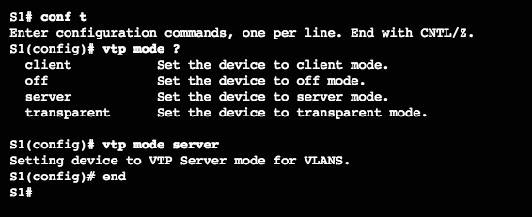
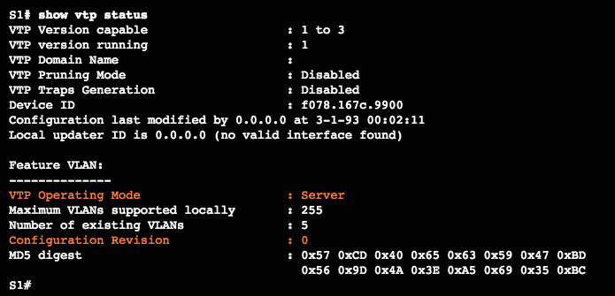
VTP Configuration Step 1 – Configure the VTP Server
Use the vtp mode server command to configure a switch as a VTP server.
Confirm all switches are configured with default configuration before issuing this command to avoid problems with configuration revision numbers.
Use the show vtp status to verify.
Notice configuration revision number is still set to 0 and number of existing VLANS is 5.
The 5 VLANs are the default VLAN 1 and VLANs 1002-1005.
Notes:
2.1 – VTP, Extended VLANs, and DTP
2.1.2 – VTP Configuration
2.1.2.2 – Step 1 – Configure the VTP Server

Slide 15
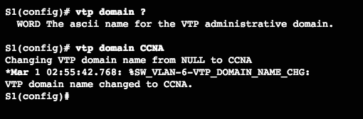
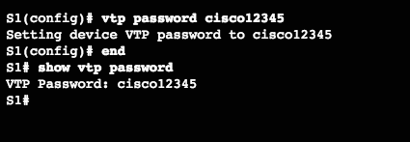
VTP Configuration Step 2 – Configure the VTP Domain Name and Password
Use the vtp domain domain-name command to configure the domain name.
VTP client must have same domain name as the VTP server before it will accept VTP advertisements.
Configure a password using the vtp password password command.
Use the show vtp password command to verify.
Notes:
2.1 – VTP, Extended VLANs, and DTP
2.1.2 – VTP Configuration
2.1.2.3 – Step 2 – Configure the VTP Domain Name and Password

Slide 16
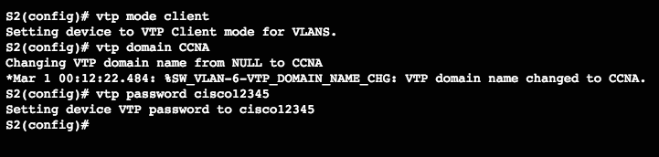
VTP Configuration Step 3 – Configure the VTP Clients
Use the vtp mode client command to configure the VTP clients.
Use same domain name and password as VTP server.
Notes:
2.1 – VTP, Extended VLANs, and DTP
2.1.2 – VTP Configuration
2.1.2.4 – Step 3 – Configure the VTP Clients

Slide 17
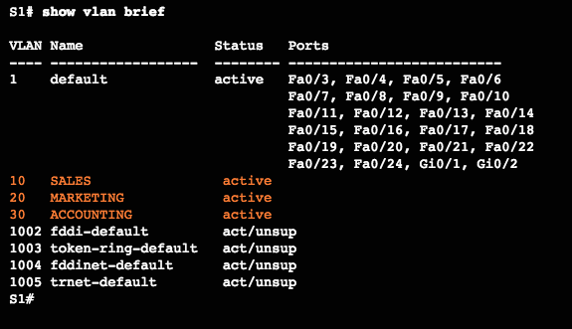
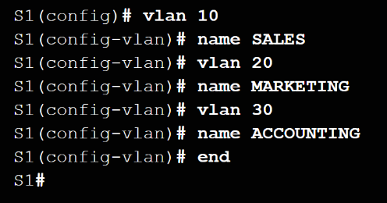
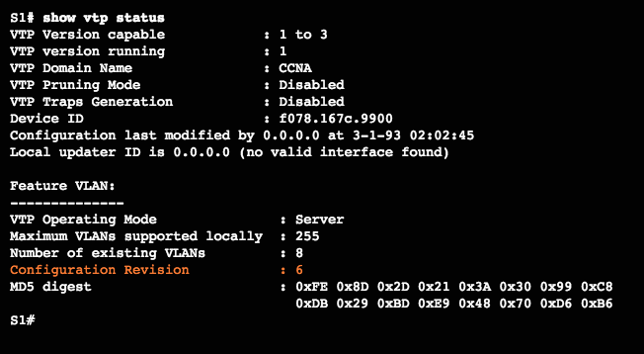
VTP Configuration Step 4 – Configure VLANs on the VTP Server
Use the vlan vlan-number command to create VLANs.
Use show vlan brief to verify the VLANs.
Use show vtp status to verify server status.
Every time a VLAN is added the configuration register is incremented
Notes:
2.1 – VTP, Extended VLANs, and DTP
2.1.2 – VTP Configuration
2.1.2.5 – Step 4 – Configure VLANs on the VTP Server

Slide 18
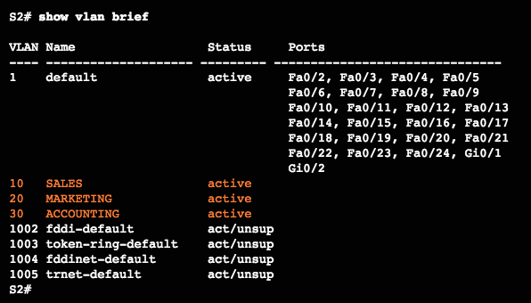
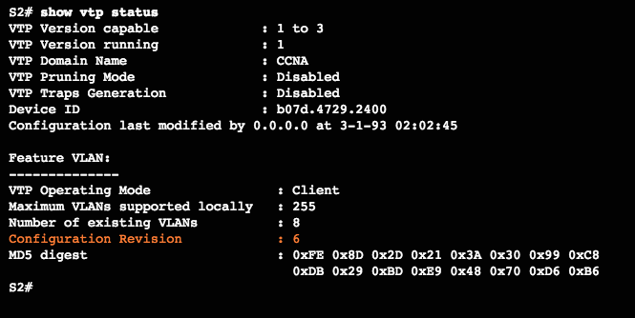
VTP Configuration Step 5 – Verify that the VTP Clients Have Received the New VLAN Information
Use the show vlan brief command to verify that the client received the new VLAN information.
Verify client status using the show vtp status command.
Notes:
2.1 – VTP, Extended VLANs, and DTP
2.1.2 – VTP Configuration
2.1.2.6– Step 5 – Verify that the VTP Clients Have Received the New VLAN Information

Slide 19
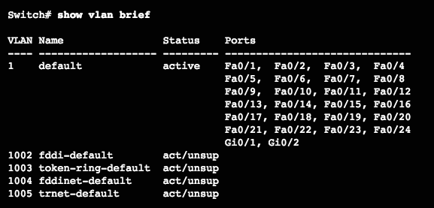
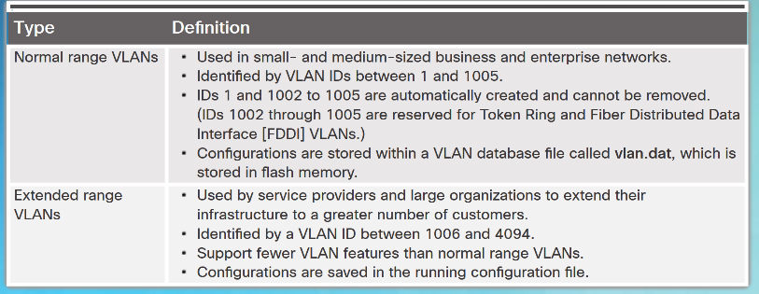
Extended VLANs VLAN Ranges on Catalyst Switches
Catalyst 2960 and 3560 Series switches support over 4,000 VLANs.
Normal range VLANs are numbered 1 to 1,005.
Stored in vlan.dat file
Extended range VLANs are numbered 1,006 to 4,094.
Not stored in vlan.dat file
VTP does not learn
Notes:
2.1 – VTP, Extended VLANs, and DTP
2.1.3 – Extended VLANs
2.1.3.1 – VLAN Ranges on Catalyst Switches

Slide 20
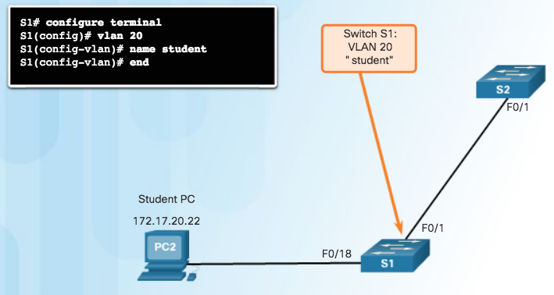
Extended VLANs Creating a VLAN
Normal range VLANs are stored in flash in vlan.dat
Use vlan vlan-id to create a VLAN
Use name vlan-name to name the VLAN
Naming each VLAN is considered a best practice in switch configuration.
To configure multiple VLANs, a series of VLAN IDs can be entered separated by commas, or a range of VLAN IDs separated by hyphens.
vlan 100,102,105-107
Notes:
2.1 – VTP, Extended VLANs, and DTP
2.1.3 – Extended VLANs
2.1.3.2 – Creating a VLAN

Slide 21
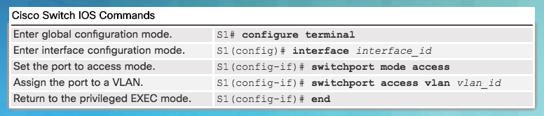
Extended VLANs Assigning Ports to VLANs
Access port can belong to only one VLAN at a time.
Only exception is when an IP phone is connected to the port. Then there are two VLANs associated with the port: one for voice and one for data.
Note: Use the interface range command to simultaneously configure multiple interfaces.
Notes:
2.1 – VTP, Extended VLANs, and DTP
2.1.3 – Extended VLANs
2.1.3.3 – Assigning Ports to VLANs

Slide 22
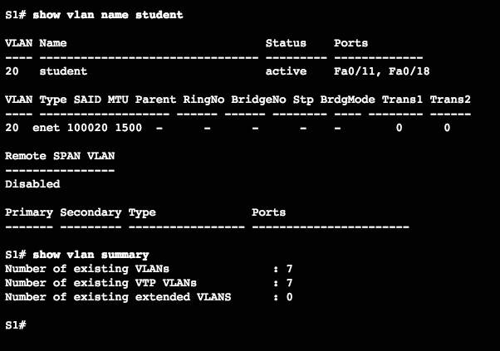
Extended VLANs Verifying VLAN Information
Commands to verify VLANs:
show vlan
show interfaces
show vlan name vlan-name
show vlan brief
show vlan summary
show interfaces vlan vlan-id
Notes:
2.1 – VTP, Extended VLANs, and DTP
2.1.3 – Extended VLANs
2.1.3.4 – Verifying VLAN Information

Slide 23
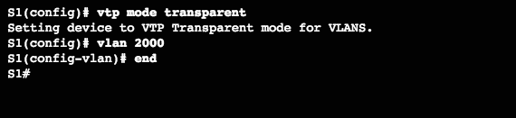
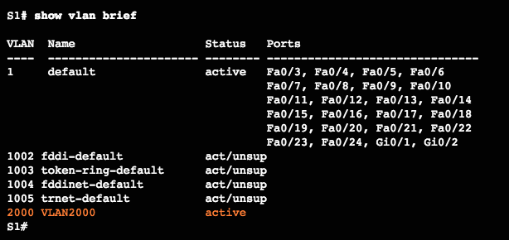
Extended VLANs Configuring Extended VLANs
Extended range VLANs are identified by a VLAN ID between 1006 and 4094.
To configure an extended VLAN on a 2960 switch it must be set to VTP transparent mode. (By default 2960 switches do not support Extended range VLANs.)
Notes:
2.1 – VTP, Extended VLANs, and DTP
2.1.3 – Extended VLANs
2.1.3.5 – Configuring Extended VLANs

Slide 24

Dynamic Trunking Protocol Introduction to DTP
Dynamic Trunking Protocol (DTP) is a proprietary Cisco protocol.
DTP characteristics are as follows:
On by default on Catalyst 2960 and 2950 switches
Dynamic-auto is default on the 2960 and 2950 switches
May be turned off with the nonegotiate command
May be turned back on by setting the interface to dynamic-auto
Setting a switch to a static trunk or static access will avoid negotiation issues with the switchport mode trunk or the switchport mode access commands.
Notes:
3 – VLANs
3.5 – Dynamic Trunking Protocol
3.5.1 – Introduction to DTP

Slide 25
Dynamic Trunking Protocol Negotiated Interface Modes
The switchport mode command has additional options.
Use the switchport nonegotiate interface configuration command to stop DTP negotiation.
Option | Description
access | Permanent access mode and negotiates to convert the neighboring link into an access link
dynamic auto | Will becomes a trunk interface if the neighboring interface is set to trunk or desirable mode
dynamic desirable | Actively seeks to become a trunk by negotiating with other auto or desirable interfaces
trunk | Permanent trunking mode and negotiates to convert the neighboring link into a trunk link
Notes:
3 – VLANs
3.5 – Dynamic Trunking Protocol
3.5.2 – Negotiated Interface Modes

Slide 26
Dynamic Trunking Protocol Results of a DTP Configuration
DTP configuration options are as follows:
 | Dynamic Auto | Dynamic Desirable | Trunk | Access
Dynamic Auto | Access | Trunk | Trunk | Access
Dynamic Desirable | Trunk | Trunk | Trunk | Access
Trunk | Trunk | Trunk | Trunk | Limited connectivity
Access | Access | Access | Limited connectivity | Access
Notes:
3 – VLANs
3.5 – Dynamic Trunking Protocol
3.5.3 – Results of a DTP Configuration

Slide 27
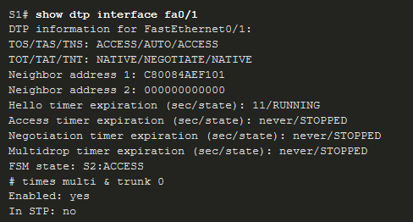
Dynamic Trunking Protocol Verify DTP Mode
The default DTP configuration is dependent on the Cisco IOS version and platform.
Use the show dtp interface command to determine the current DTP mode.
Best practice recommends that the interfaces be set to access or trunk and to turnoff DTP
Notes:
3 – VLANs
3.5 – Dynamic Trunking Protocol
3.5.4 – Verify DTP Mode

Slide 28
2.2 Troubleshoot Multi-VLAN Issues
Notes:
2 – Scaling VLANs
2.2 – Troubleshoot Multi-VLAN issues

Slide 29
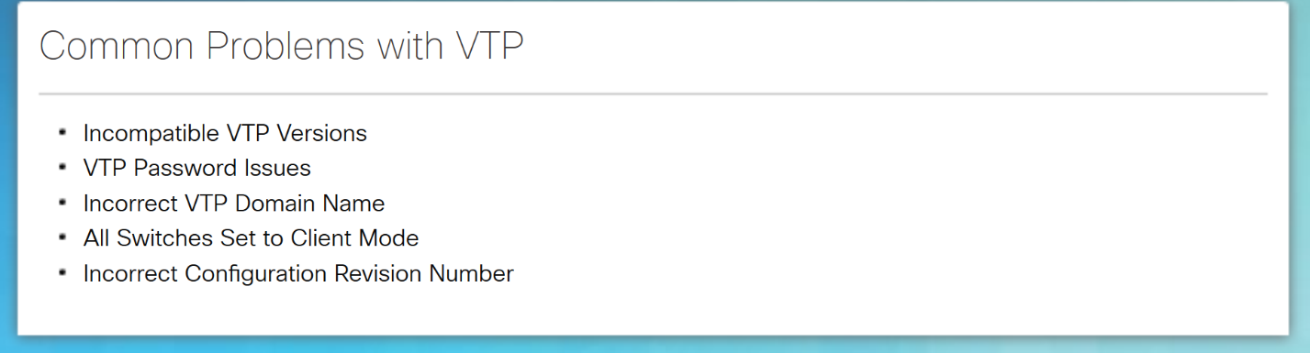
VTP and DTP Issues Troubleshoot VTP Issues
Notes:
2.2 – Troubleshoot Multi-VLAN Issues
2.2.3 – VTP and DTP Issues
2.2.3.1 – Troubleshoot VTP Issues

Slide 30
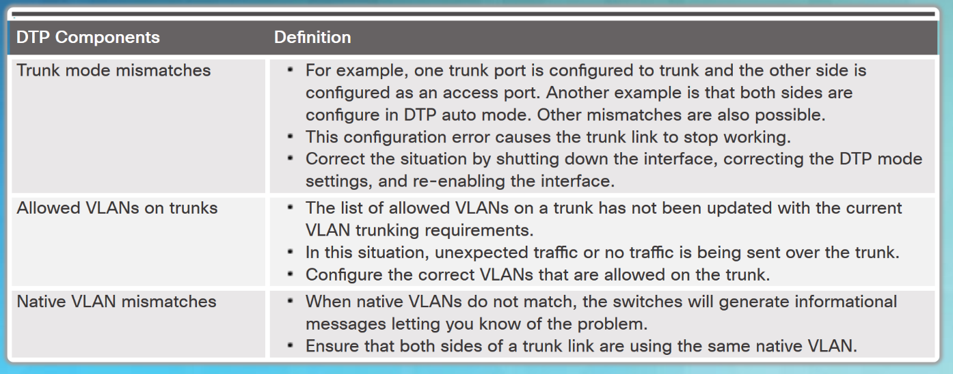
VTP and DTP Issues Troubleshoot DTP Issues
Common Problems with Trunks
Notes:
2.2 – Troubleshoot Multi-VLAN Issues
2.2.3 – VTP and DTP Issues
2.2.3.2 – Troubleshoot DTP Issues

Slide 31
2.3 Inter-VLAN Routing Operation
Notes:
4- Inter-VLAN Routing
4.1 – Inter-VLAN Routing Operation

Slide 32
Inter-VLAN Routing Operation What is Inter-VLAN Routing?
VLANs are used to segment switched Layer 2 networks for a variety of reasons. Regardless of the reason, hosts in one VLAN cannot communicate with hosts in another VLAN unless there is a router or a Layer 3 switch to provide routing services.
Inter-VLAN routing is the process of forwarding network traffic from one VLAN to another VLAN.
There are three inter-VLAN routing options:
Legacy Inter-VLAN routing - This is a legacy solution. It does not scale well.
Router-on-a-Stick - This is an acceptable solution for a small to medium-sized network.
Layer 3 switch using switched virtual interfaces (SVIs) - This is the most scalable solution for medium to large organizations.
Notes:
4 – Inter-VLAN Routing
4.1 – Inter-VLAN Routing Operation
4.1.1 - What is Inter-VLAN Routing?

Slide 33
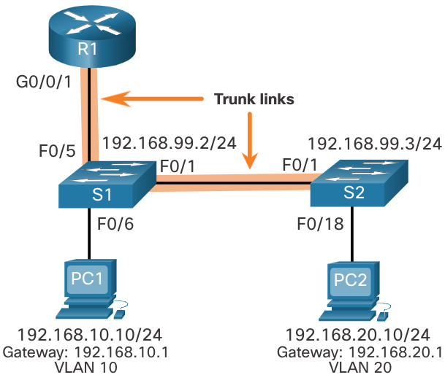
Router-on-a-Stick Inter-VLAN Routing Router-on-a-Stick Scenario
In the figure, the R1 GigabitEthernet 0/0/1 interface is connected to the S1 FastEthernet 0/5 port. The S1 FastEthernet 0/1 port is connected to the S2 FastEthernet 0/1 port. These are trunk links that are required to forward traffic within and between VLANs.
To route between VLANs, the R1 GigabitEthernet 0/0/1 interface is logically divided into three subinterfaces, as shown in the table. The table also shows the three VLANs that will be configured on the switches.
Assume that R1, S1, and S2 have initial basic configurations. Currently, PC1 and PC2 cannot ping each other because they are on separate networks. Only S1 and S2 can ping each other, but they but are unreachable by PC1 or PC2 because they are also on different networks.
To enable devices to ping each other, the switches must be configured with VLANs and trunking, and the router must be configured for inter-VLAN routing.
Subinterface | VLAN | IP Address
G0/0/1.10 | 10 | 192.168.10.1/24
G0/0/1.20 | 20 | 192.168.20.1/24
G0/0/1.30 | 99 | 192.168.99.1/24
Notes:
4 – Inter-VLAN Routing
4.2 - Router-on-a-Stick Inter-VLAN Routing
4.2.1 – Router-on-a-Stick Scenario

Slide 34
Router-on-a-Stick Inter-VLAN Routing R1 Subinterface Configuration
The router-on-a-stick method requires you to create a subinterface for each VLAN to be routed. A subinterface is created using the interface interface_id subinterface_id global configuration mode command. The subinterface syntax is the physical interface followed by a period and a subinterface number. Although not required, it is customary to match the subinterface number with the VLAN number.
Each subinterface is then configured with the following two commands:
encapsulation dot1q vlan_id [native] - This command configures the subinterface to respond to 802.1Q encapsulated traffic from the specified vlan-id. The native keyword option is only appended to set the native VLAN to something other than VLAN 1.
ip address ip-address subnet-mask - This command configures the IPv4 address of the subinterface. This address typically serves as the default gateway for the identified VLAN.
Repeat the process for each VLAN to be routed. Each router subinterface must be assigned an IP address on a unique subnet for routing to occur. When all subinterfaces have been created, enable the physical interface using the no shutdown interface configuration command. If the physical interface is disabled, all subinterfaces are disabled.
Notes:
4 – Inter-VLAN Routing
4.2 - Router-on-a-Stick Inter-VLAN Routing
4.2.4 – R1 Subinterface Configuration

Slide 35
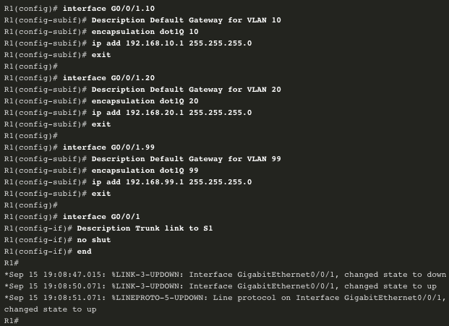
Router-on-a-Stick Inter-VLAN Routing R1 Subinterface Configuration (Cont.)
In the configuration, the R1 G0/0/1 subinterfaces are configured for VLANs 10, 20, and 99.
Notes:
4 – Inter-VLAN Routing
4.2 - Router-on-a-Stick Inter-VLAN Routing
4.2.4 – R1 Subinterface Configuration (Cont.)

Slide 36
Inter-VLAN Routing using Layer 3 Switches Layer 3 Switch Inter-VLAN Routing
Inter-VLAN routing using the router-on-a-stick method is simple to implement for a small to medium-sized organization. However, a large enterprise requires a faster, much more scalable method to provide inter-VLAN routing.
Enterprise campus LANs use Layer 3 switches to provide inter-VLAN routing. Layer 3 switches use hardware-based switching to achieve higher-packet processing rates than routers. Layer 3 switches are also commonly implemented in enterprise distribution layer wiring closets.
Capabilities of a Layer 3 switch include the ability to do the following:
Route from one VLAN to another using multiple switched virtual interfaces (SVIs).
Convert a Layer 2 switchport to a Layer 3 interface (i.e., a routed port). A routed port is similar to a physical interface on a Cisco IOS router.
To provide inter-VLAN routing, Layer 3 switches use SVIs. SVIs are configured using the same interface vlan vlan-id command used to create the management SVI on a Layer 2 switch. A Layer 3 SVI must be created for each of the routable VLANs.
Notes:
4 – Inter-VLAN Routing
4.3 – Inter-VLAN Routing using Layer 3 Switches
4.3.1 – Layer 3 Switch Inter-VLAN Routing

Slide 37
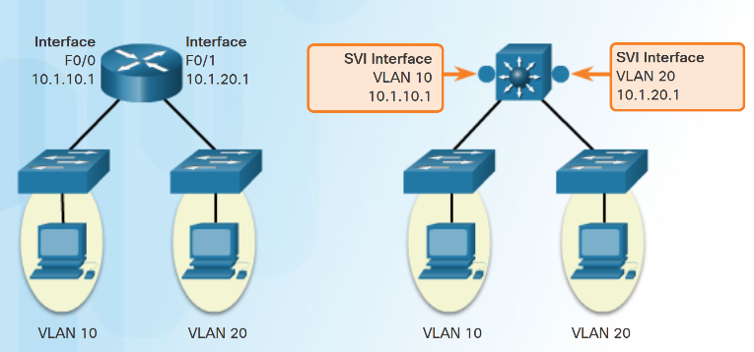
Layer 3 Switching Operation and Configuration Inter-VLAN Routing with Switch Virtual Interfaces
An SVI is a virtual interface that is configured within a multilayer switch:
To provide a gateway for a VLAN so that traffic can be routed into or out of that VLAN.
To provide Layer 3 IP connectivity to the switch.
To support routing protocol and bridging configurations.
Advantages of SVIs:
Faster than router-on-a-stick.
No need for external links from the switch to the router for routing.
Not limited to one link. Layer 2 EtherChannels can be used to get more bandwidth.
Notes:
2.3 – Layer 3 Switching
2.3.1 – Layer 3 Switching Operation and Configuration
2.3.1.3 – Inter-VLAN Routing with Switch Virtual Interfaces (Cont.)

Slide 38
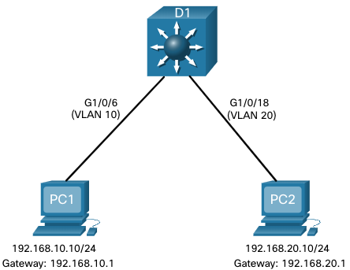
Inter-VLAN Routing using Layer 3 Switches Layer 3 Switch Scenario
In the figure, the Layer 3 switch, D1, is connected to two hosts on different VLANs. PC1 is in VLAN 10 and PC2 is in VLAN 20, as shown. The Layer 3 switch will provide inter-VLAN routing services to the two hosts.
Notes:
4 – Inter-VLAN Routing
4.3 – Inter-VLAN Routing using Layer 3 Switches
4.3.2 – Layer 3 Switch Scenario

Slide 39
Inter-VLAN Routing using Layer 3 Switches Layer 3 Switch Configuration
Complete the following steps to configure S1 with VLANs and trunking:
Step 1. Create the VLANs. In the example, VLANs 10 and 20 are used.
Step 2. Create the SVI VLAN interfaces. The IP address configured will serve as the default gateway for hosts in the respective VLAN.
Step 3. Configure access ports. Assign the appropriate port to the required VLAN.
Step 4. Enable IP routing. Issue the ip routing global configuration command to allow traffic to be exchanged between VLANs 10 and 20. This command must be configured to enable inter-VAN routing on a Layer 3 switch for IPv4.
Inter-VLAN routing using a Layer 3 switch is simpler to configure than the router-on-a-stick method. After the configuration is complete, the configuration can be verified by testing connectivity between the hosts.
Notes:
4 – Inter-VLAN Routing
4.3 – Inter-VLAN Routing using Layer 3 Switches
4.3.3 – Layer 3 Switch Configuration

Slide 40
Inter-VLAN Routing using Layer 3 Switches Routing on a Layer 3 Switch
If VLANs are to be reachable by other Layer 3 devices, then they must be advertised using static or dynamic routing. To enable routing on a Layer 3 switch, a routed port must be configured.
A routed port is created on a Layer 3 switch by disabling the switchport feature on a Layer 2 port that is connected to another Layer 3 device. Specifically, configuring the no switchport interface configuration command on a Layer 2 port converts it into a Layer 3 interface. Then the interface can be configured with an IPv4 configuration to connect to a router or another Layer 3 switch.
Notes:
4 – Inter-VLAN Routing
4.3 – Inter-VLAN Routing using Layer 3 Switches
4.3.5 - Routing on a Layer 3 Switch

Slide 41
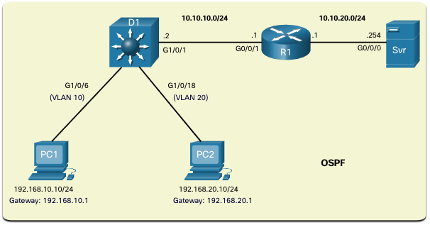
Inter-VLAN Routing using Layer 3 Switches Routing Scenario on a Layer 3 Switch
In the figure, the previously configured D1 Layer 3 switch is now connected to R1. R1 and D1 are both in an Open Shortest Path First (OSPF) routing protocol domain. Assume inter-VLAN has been successfully implemented on D1. The G0/0/1 interface of R1 has also been configured and enabled. Additionally, R1 is using OSPF to advertise its two networks, 10.10.10.0/24 and 10.20.20.0/24.
Notes:
4 – Inter-VLAN Routing
4.3 – Inter-VLAN Routing using Layer 3 Switches
4.3.6 - Routing Scenario on a Layer 3 Switch

Slide 42
Inter-VLAN Routing using Layer 3 Switches Routing Configuration on a Layer 3 Switch
Complete the following steps to configure D1 to route with R1:
Step 1. Configure the routed port. Use the no switchport command to convert the port to a routed port, then assign an IP address and subnet mask. Enable the port.
Step 2. Enable routing. Use the ip routing global configuration command to enable routing.
Step 3. Configure routing. Use an appropriate routing method. In this example, Single-Area OSPFv2 is configured
Step 4. Verify routing. Use the show ip route command.
Step 5. Verify connectivity. Use the ping command to verify reachability.
Notes:
4 – Inter-VLAN Routing
4.3 – Inter-VLAN Routing using Layer 3 Switches
4.3.7 – Routing Configuration on a Layer 3 Switch

Slide 43
2.4 Troubleshoot Inter-VLAN Routing
Notes:
4- Inter-VLAN Routing
4.4 – Troubleshoot Inter-VLAN Routing

Slide 44
Troubleshoot Inter-VLAN Routing Common Inter-VLAN Issues
There are a number of reasons why an inter-VAN configuration may not work. All are related to connectivity issues. First, check the physical layer to resolve any issues where a cable might be connected to the wrong port. If the connections are correct, then use the list in the table for other common reasons why inter-VLAN connectivity may fail.
Issue Type | How to Fix | How to Verify
Missing VLANs | Create (or re-create) the VLAN if it does not exist. Ensure host port is assigned to the correct VLAN. | show vlan [brief] show interfaces switchport ping
Switch Trunk Port Issues | Ensure trunks are configured correctly. Ensure port is a trunk port and enabled. | show interface trunk show running-config
Switch Access Port Issues | Assign correct VLAN to access port. Ensure port is an access port and enabled. Host is incorrectly configured in the wrong subnet. | show interfaces switchport show running-config interface ipconfig
Router Configuration Issues | Router subinterface IPv4 address is incorrectly configured. Router subinterface is assigned to the VLAN ID. | show ip interface brief show interfaces
Notes:
4 – Inter-VLAN Routing
4.4 - Troubleshoot Inter-VLAN Routing
4.4.1 – Common Inter-VLAN Issues

Slide 45
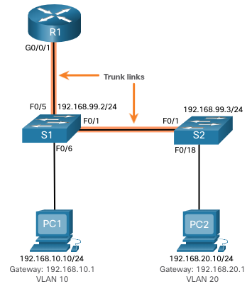
Troubleshoot Inter-VLAN Routing Troubleshoot Inter-VLAN Routing Scenario
This topology will be used for all of these issues.
Router R1 Subinterfaces
Subinterface | VLAN | IP Address
G0/0/0.10 | 10 | 192.168.10.1/24
G0/0/0.20 | 20 | 192.168.20.1/24
G0/0/0.30 | 99 | 192.168.99.1/24
Notes:
4 – Inter-VLAN Routing
4.4 - Troubleshoot Inter-VLAN Routing
4.4.2 – Troubleshoot Inter-VLAN Routing Scenario

Slide 46
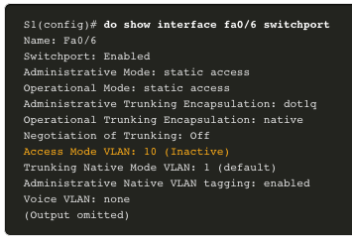
Troubleshoot Inter-VLAN Routing Missing VLANs
An inter-VLAN connectivity issue could be caused by a missing VLAN. The VLAN could be missing if it was not created, it was accidently deleted, or it is not allowed on the trunk link.
When a VLAN is deleted, any ports assigned to that VLAN become inactive. They remain associated with the VLAN (and thus inactive) until you assign them to a new VLAN or recreate the missing VLAN. Recreating the missing VLAN would automatically reassign the hosts to it.
Use the show interface interface-id switchport command to verify the VLAN membership of the port.
Notes:
4 – Inter-VLAN Routing
4.4 - Troubleshoot Inter-VLAN Routing
4.4.3 – Missing VLANs

Slide 47
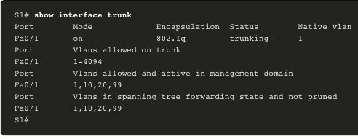
Troubleshoot Inter-VLAN Routing Switch Trunk Port Issues
Another issue for inter-VLAN routing includes misconfigured switch ports. In a legacy inter-VLAN solution, this could be caused when the connecting router port is not assigned to the correct VLAN.
However, with a router-on-a-stick solution, the most common cause is a misconfigured trunk port.
Verify that the port connecting to the router is correctly configured as a trunk link using the show interface trunk command.
If that port is missing from the output, examine the configuration of the port with the show running-config interface X command to see how the port is configured.
Notes:
4 – Inter-VLAN Routing
4.4 - Troubleshoot Inter-VLAN Routing
4.4.4 – Switch Trunk Port Issues

Slide 48
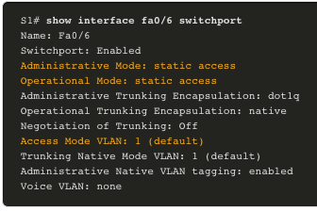
Troubleshoot Inter-VLAN Routing Switch Access Port Issues
When a problem is suspected with a switch access port configuration, use verification commands to examine the configuration and identify the problem.
A common indicator of this issue is the PC having the correct address configuration (IP Address, Subnet Mask, Default Gateway), but being unable to ping its default gateway.
Use the show vlan brief, show interface X switchport or show running-config interface X command to verify the interface VLAN assignment.
Notes:
4 – Inter-VLAN Routing
4.4 - Troubleshoot Inter-VLAN Routing
4.4.5 – Switch Access Port Issues

Slide 49
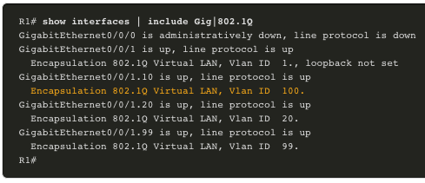
Troubleshoot Inter-VLAN Routing Router Configuration Issues
Router-on-a-stick configuration problems are usually related to subinterface misconfigurations.
Verify the subinterface status using the show ip interface brief command.
Verify which VLANs each of the subinterfaces is on. To do so, the show interfaces command is useful but it generates a great deal of additional unrequired output. The command output can be reduced using IOS command filters. In this example, use the include keyword to identify that only lines containing the letters “Gig” or “802.1Q”
Notes:
4 – Inter-VLAN Routing
4.4 - Troubleshoot Inter-VLAN Routing
4.4.6 – Router Configuration Issues
4.4.7 – Check Your Understanding – Troubleshoot Inter-VLAN Routing

Slide 50
2.5 Chapter Summary
Notes:
2 – Scaling VLANs
2.3 – Summary

Slide 51
Conclusion Chapter 2: Scaling VLANs
Configure enhanced inter-switch connectivity technologies.
Troubleshoot issues in an inter-VLAN routing environment.
Implement inter-VLAN routing using Layer 3 switching to forward data in a small to medium-sized business LAN.
Notes:
2.3 – Summary
2.3.1 – Conclusion
2.3.1.1 – Chapter 2: Scaling VLANs

